Slide 1
Predicting the car accident rate

Slide 2
Background
Car accidents happen frequently → disastrous impact
The situation still cannot improve
Which location has the highest severity of accidents?
Under what weather conditions, will the accidents occur frequently?
Under which combination of factors, will severity of accidents be the highest?

Slide 3
Data acquisition and cleaning
Data source: Data-Collisions.csv
Data cleaning: replace the missing value with NaN
Replace the categorial variable to numeric value

Slide 4
Exploratory Data Analysis

Slide 5
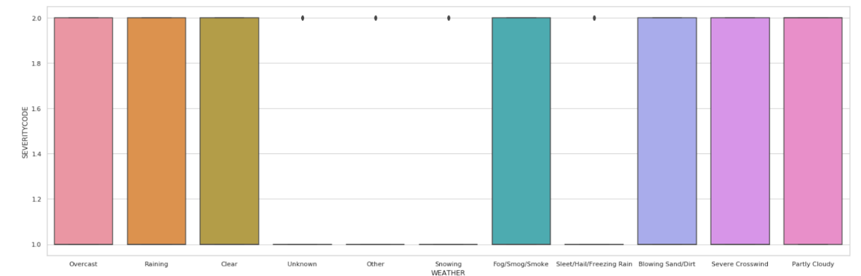
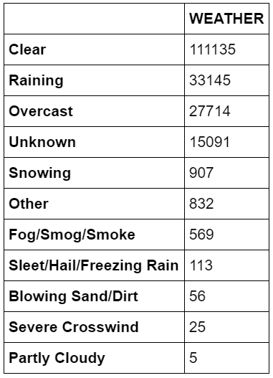
Weather condition and severity

Slide 6
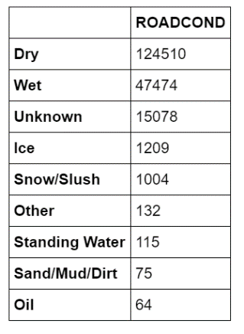
Road condition and accident

Slide 7
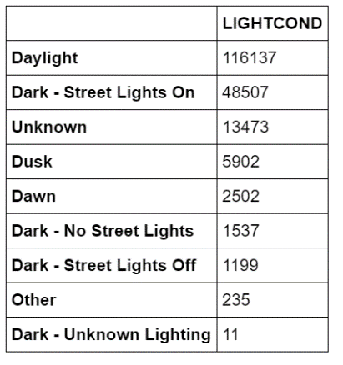
Light condition and accident

Slide 8
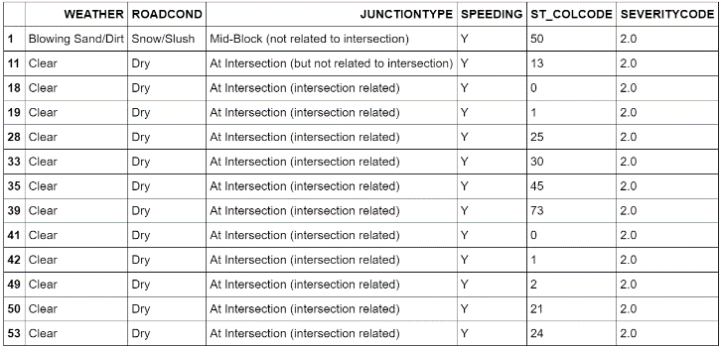
Combination of factors

Slide 9
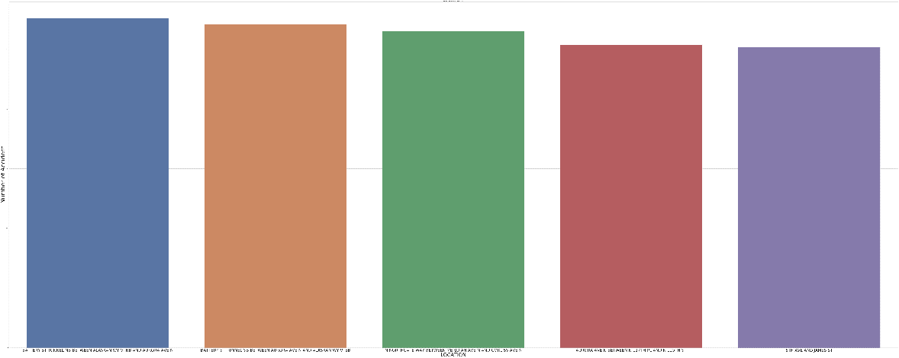
Modeling

Slide 10
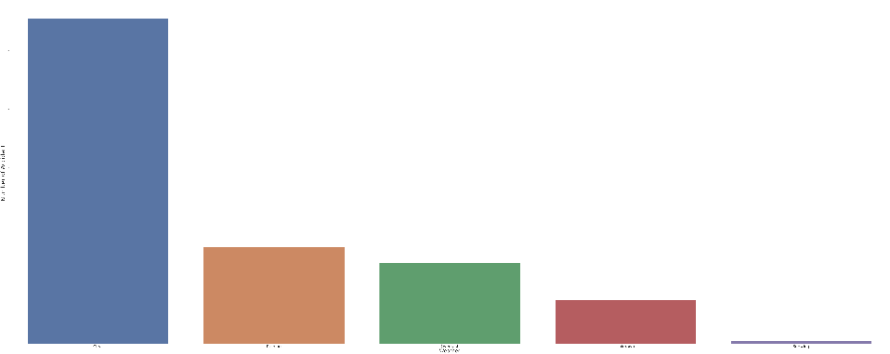
Weather

Slide 11
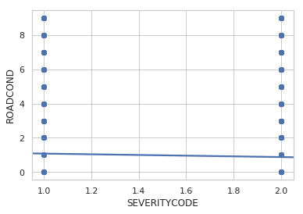
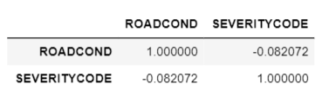
Road condition

Slide 12
Conclusion
Clear Weather
Dry road condition
Speeding
Intersection

Slide 13
Future direction
Decision tree and classification model
More datasets and variables
Training and testing data

